Slide 1
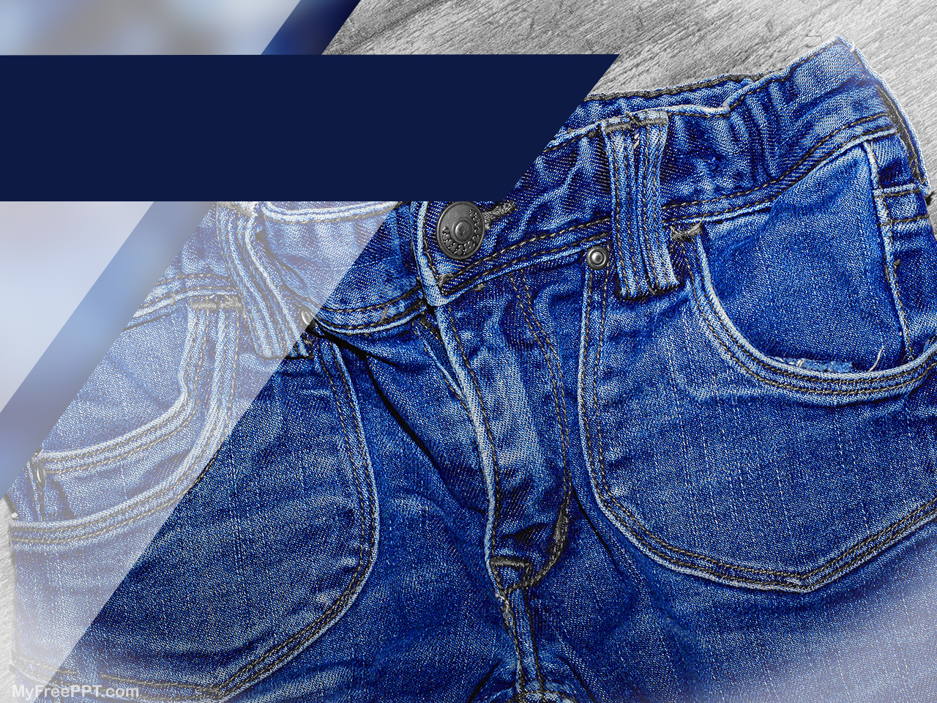

Clothes
4. r - 12. 1. 2021

Slide 2
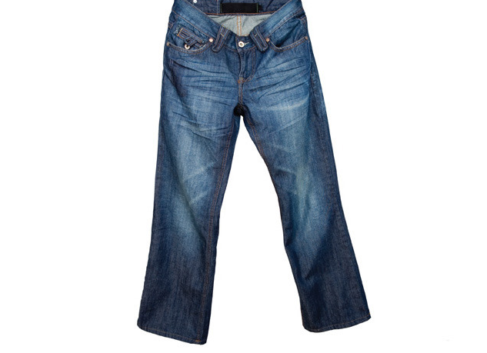
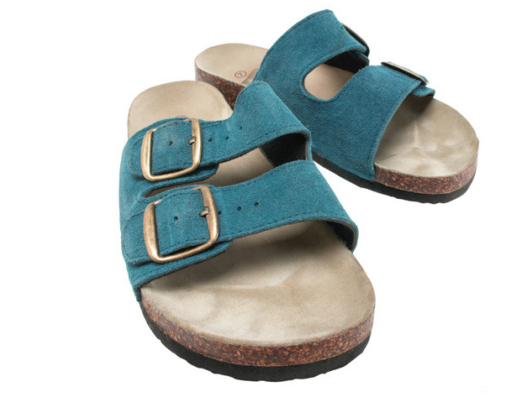
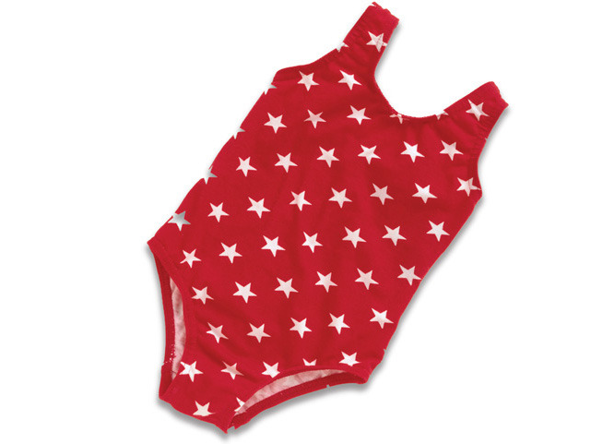
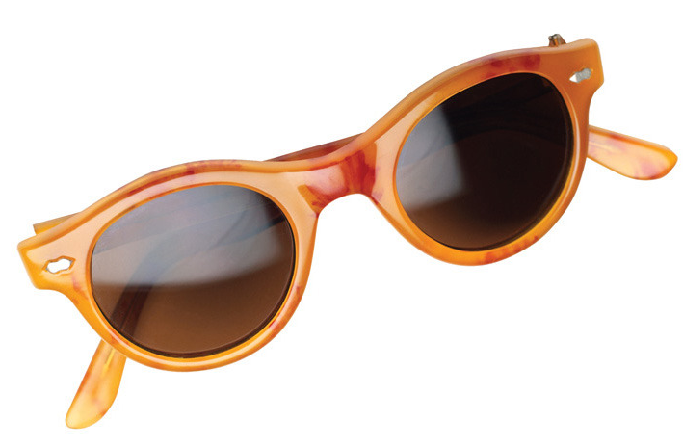
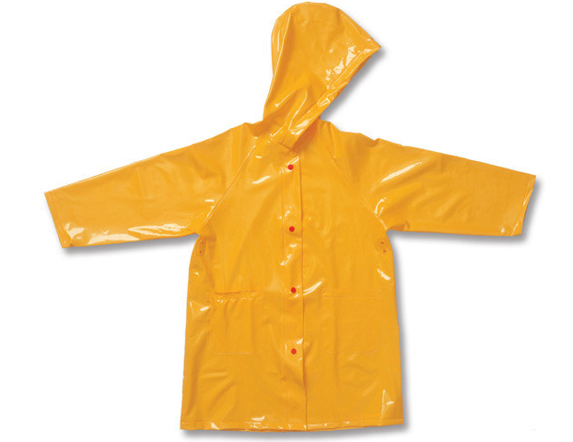
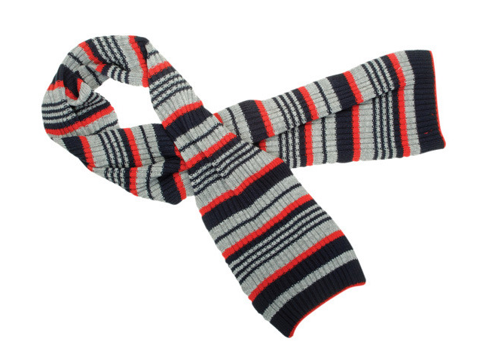
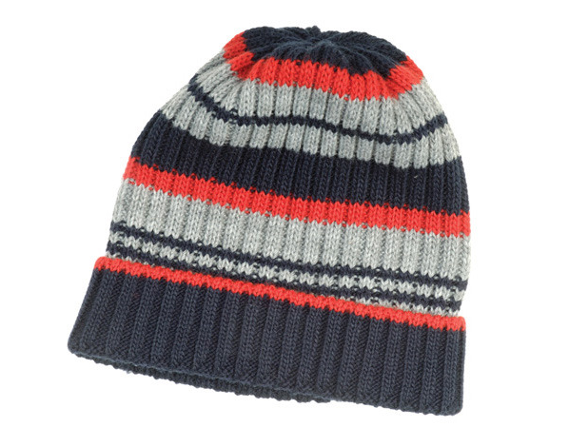
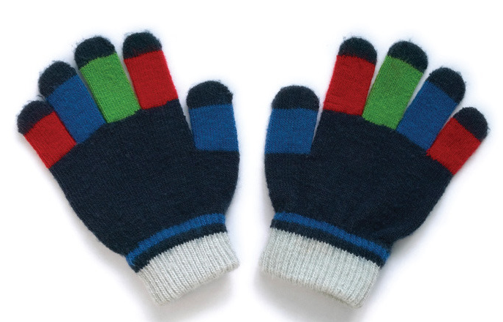
Clothes
sunglasses
sandals
swimsuit
jeans
scarf
raincoat
woolly hat
gloves

Slide 3
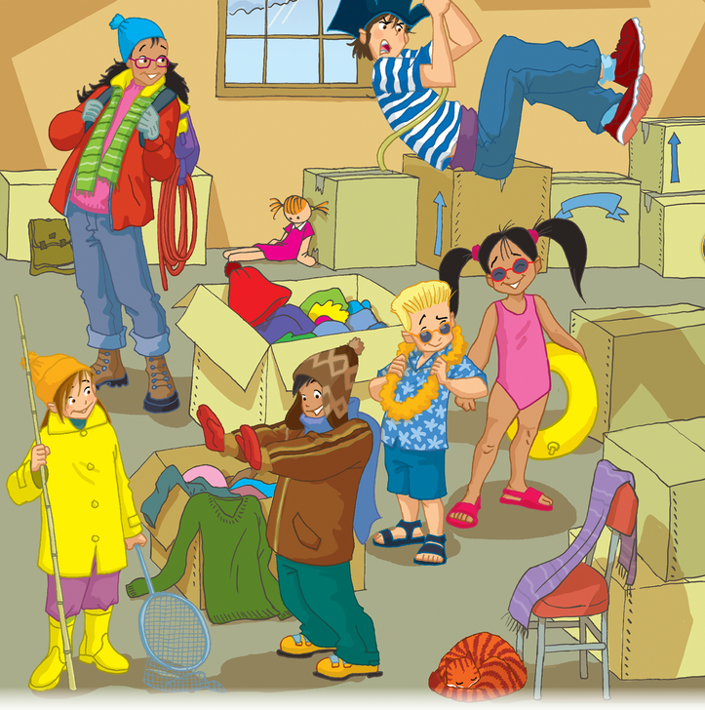
I’m wearing a yellow raincoat.
I’m wearing red gloves.
I’m wearing blue shorts.
I’m wearing a pink swimsuit.
I’m wearing a green scarf.
I’m wearing blue jeans.

Slide 4
Sofie is wearing a yellow raincoat.
She’s wearing a yellow raincoat.
Sam is wearing red gloves.
He’s wearing red gloves.
Nick is wearing blue shorts.
He’s wearing blue shorts.
Lucy is wearing a pink swimsuit.
She’s wearing a pink swimsuit.
Carla is wearing a green scarf.
She’s wearing a green scarf.
Mike is wearing blue jeans.
He’s wearing blue jeans.

Slide 5
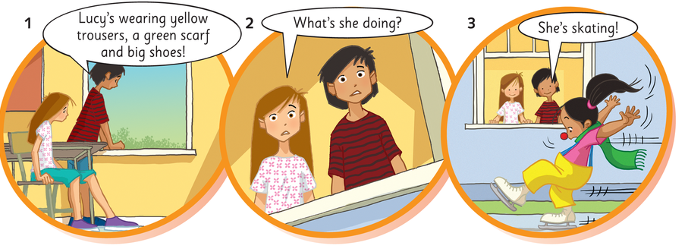
Lucy’s wearing…

Slide 6
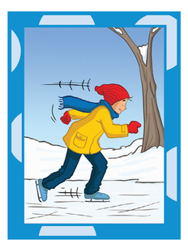
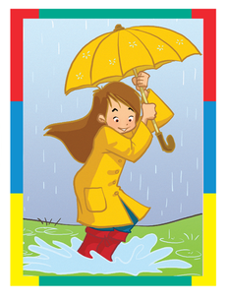
She’s wearing a yellow raincoat.
She’s jumping
What’s he/she wearing…
What’s he/she doing…
He’s wearing blue jeans.
He’s skating.

Slide 7
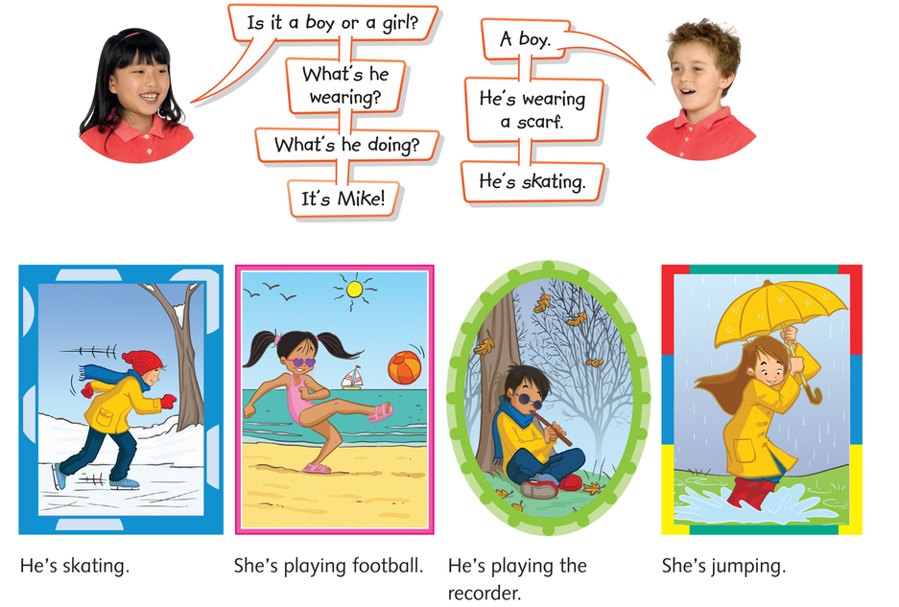
What’s he wearing?
What’s he doing?

Slide 8
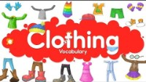
Clothing vocabulary

Slide 9
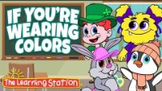
If you’re wearing colors

Slide 10
Exercises
Exercise 1
Exercise 2
DZ: str. 27, 2. naloga
Oxford Young Explorers Online Practice:
  Clothes, Lesson 1
  Clothes, Lesson 2

